Slide 1
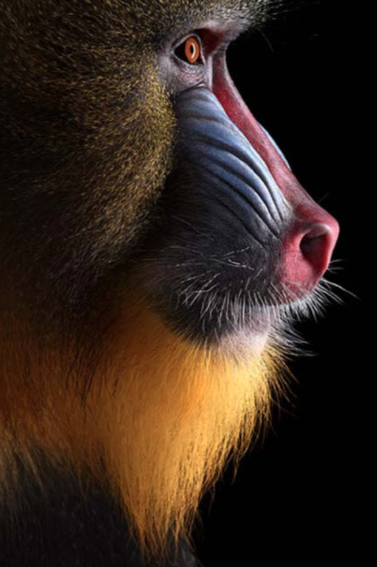
Building an informed coalition: Situation analysis in Kinshasa and Brazzaville
Juliet Wright, WCS Bushmeat Research Coordinator
jwright@wcs.org

Slide 2
Learning from and scaling up
Pointe Noire
Pop. 1,000,000
Brazzaville and Kinshasa
Pop. 15,000,000

Slide 3
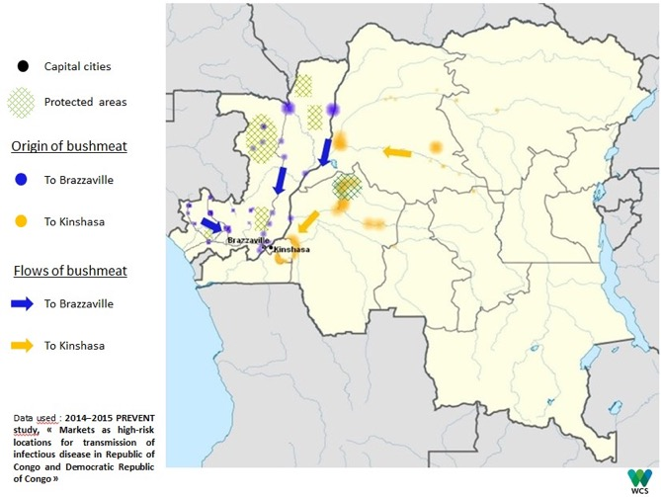
Urban demand
Source: FHI 360

Slide 4
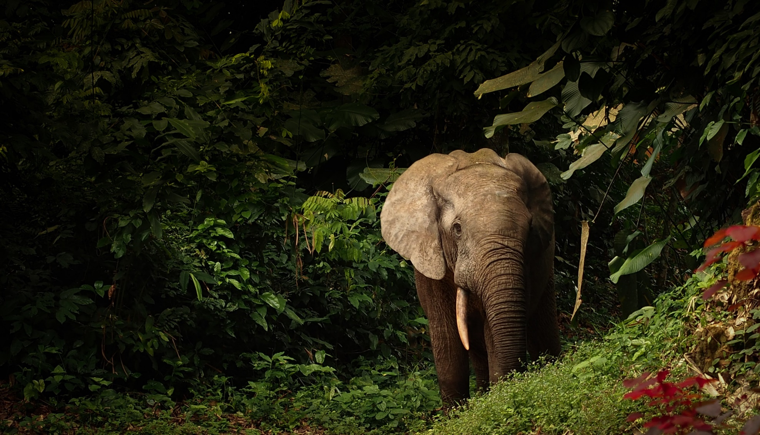
Critical role in healthy Congo Basin forests
Central Africa’s wildlife is disappearing
F Hogg, WCS
Notes:
its got our 2nd lungs of the planet….more and more research is coming out saying the forest can’t thrive without its big mammals
Trophic cascades:
Forest structure and function:
Climate change:
Food security:

Slide 5
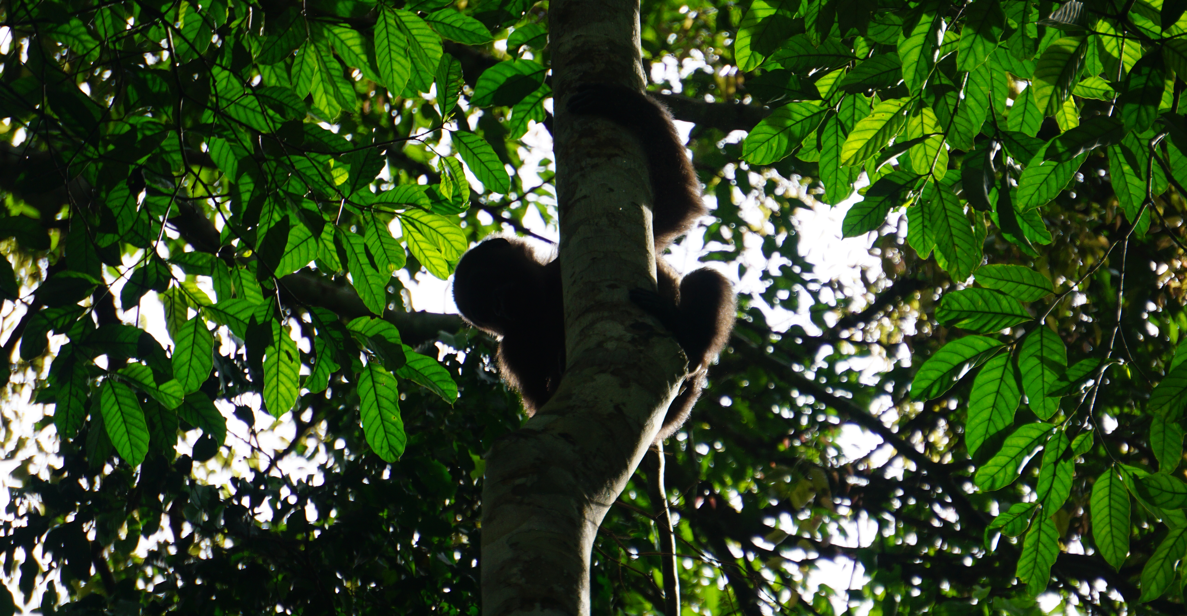
Critical role in healthy Congo Basin forests
Central Africa’s wildlife is disappearing
Notes:
its got our 2nd lungs of the planet….more and more research is coming out saying the forest can’t thrive without its big mammals
Trophic cascades:
Forest structure and function:
Climate change:
Food security:

Slide 6
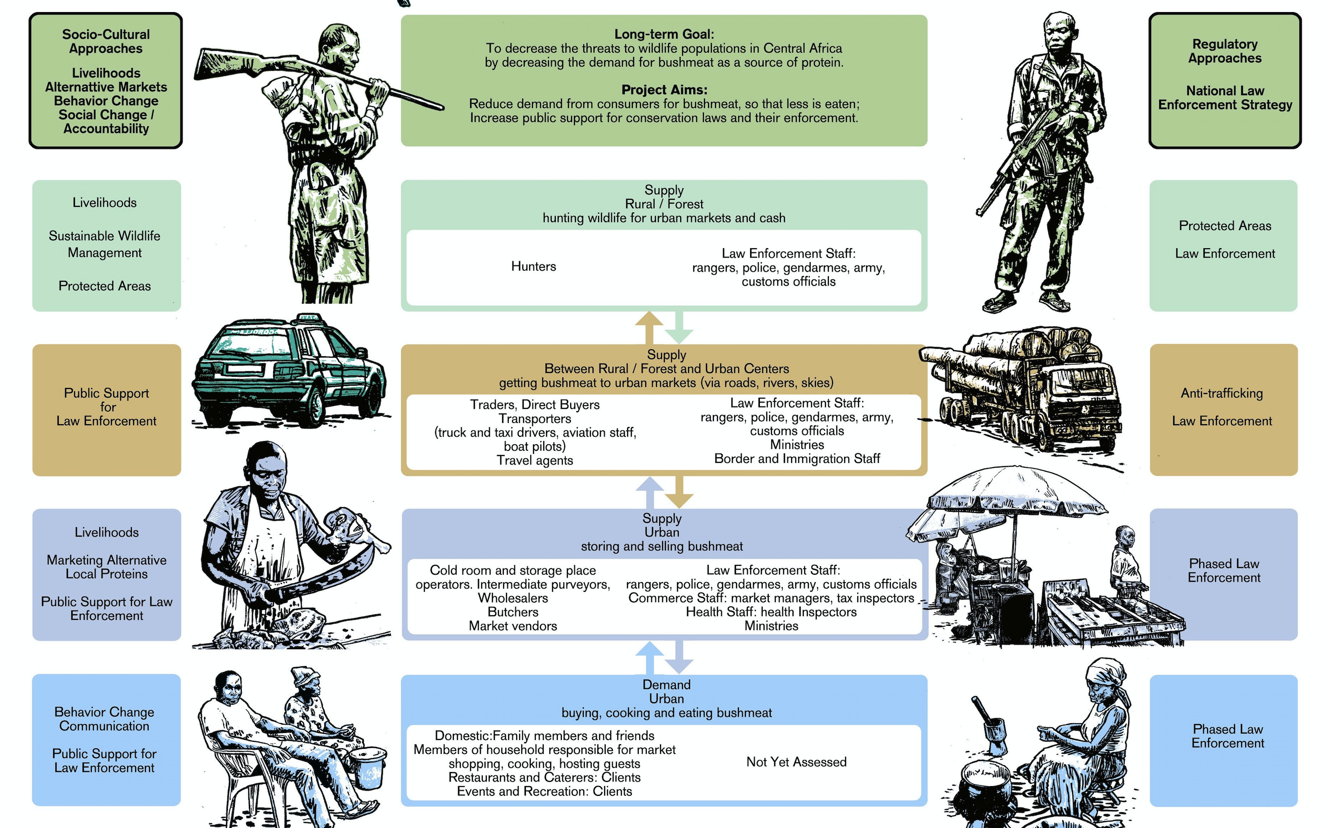
Urban demand

Slide 7
Three strands of research
consumer demand
social marketing
behaviour change
overt supply
criminology
situational crime prevention
covert supply
investigations
law enforcement
Evidence-informed interventions
Notes:
Three strands of research will be conducted concurrently to lead towards the design, implementation and evaluation of these interventions .

Slide 8
City-wide situation analysis
Five surveys
18 months
May 2017 - October 2018
Quantitative
14 Congolese research assistants
Data analysis ongoing

Slide 9
Problem definition
Prevalence and frequency of bushmeat consumption
Proportion of restaurants and markets overtly selling bushmeat

Slide 10
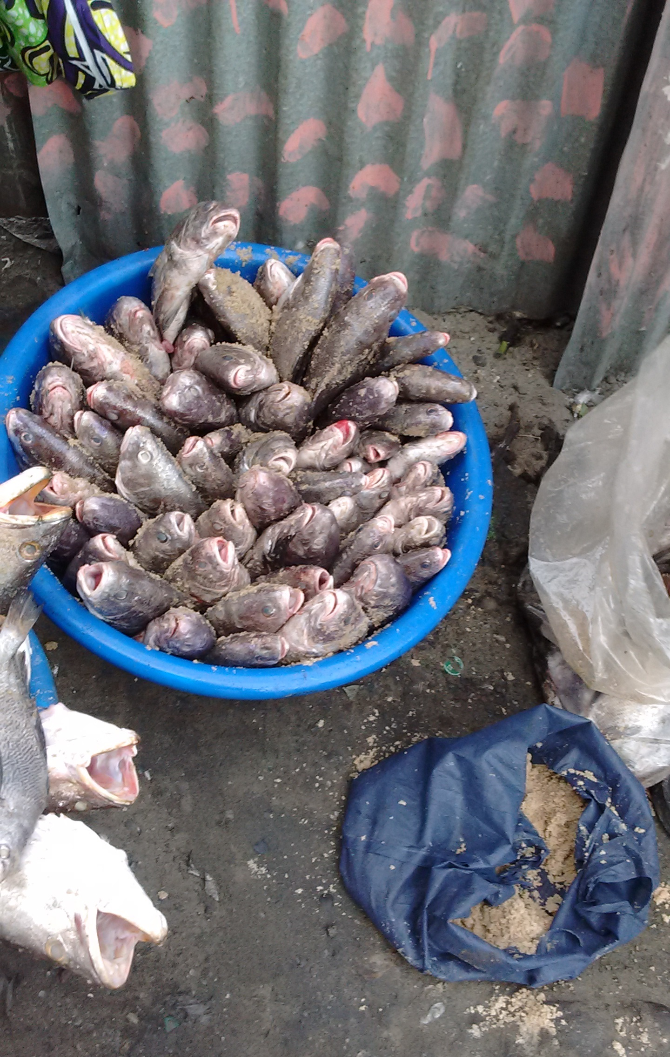
Contextual analysis
Prevalence and frequency of consumption of other protein types
Availability of alternative proteins

Slide 11
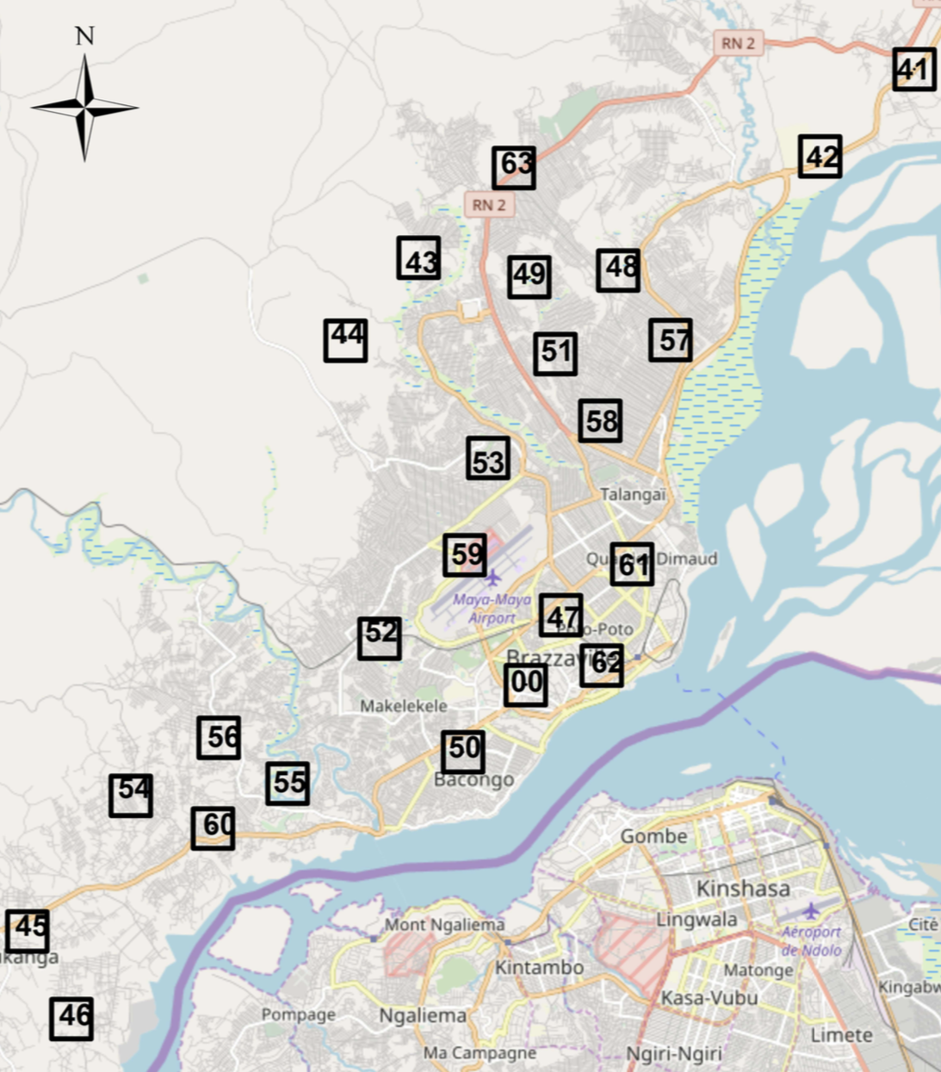
Sampling frame – 63 one-km sq quadrats
Kinshasa
Brazzaville

Slide 12
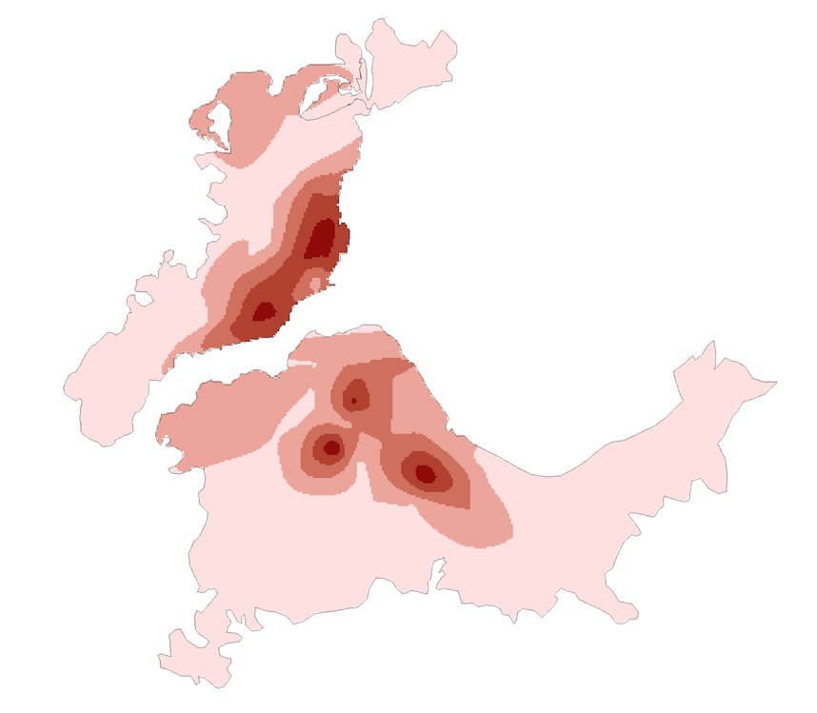
Survey 1 – mapping
Protein outlets and public gathering points
May 2017 – January 2018
Mobile navigation app OsmAnd
Data collected in KoBoCollect
2071 POI mapped in Brazzaville
8197 POI mapped in Kinshasa
Density of protein selling outlets
Notes:
The following protein selling outlets were mapped across both cities: bakeries, butchers, cold stores, farms, fishmongers, general food shops, formal restaurants, informal restaurants, markets, street vendors and supermarkets. In addition, the following public gathering places were mapped: bus stops, churches, banks, health centres, petrol stations, public taps, schools, transport hubs, universities and utility company offices.

Slide 13
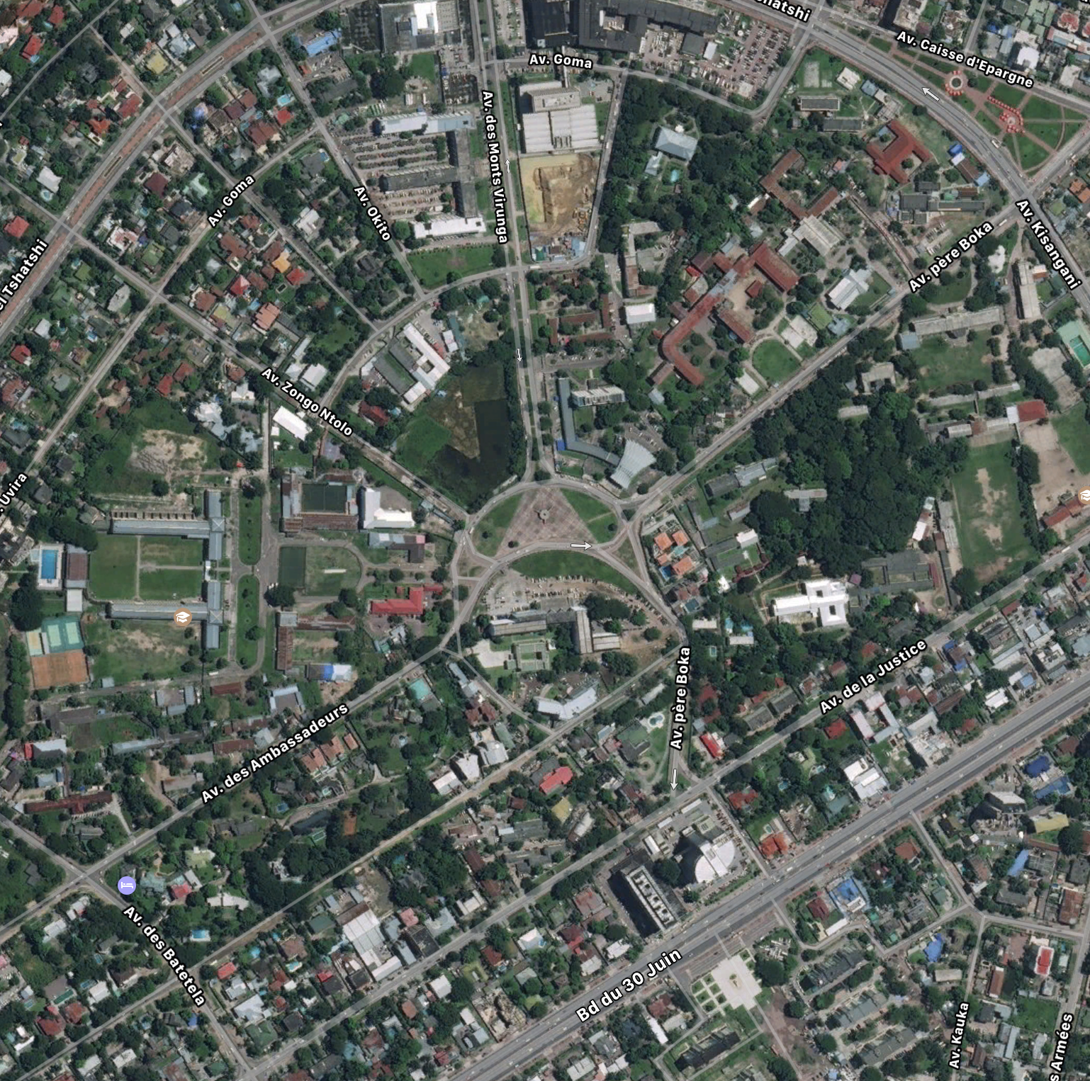
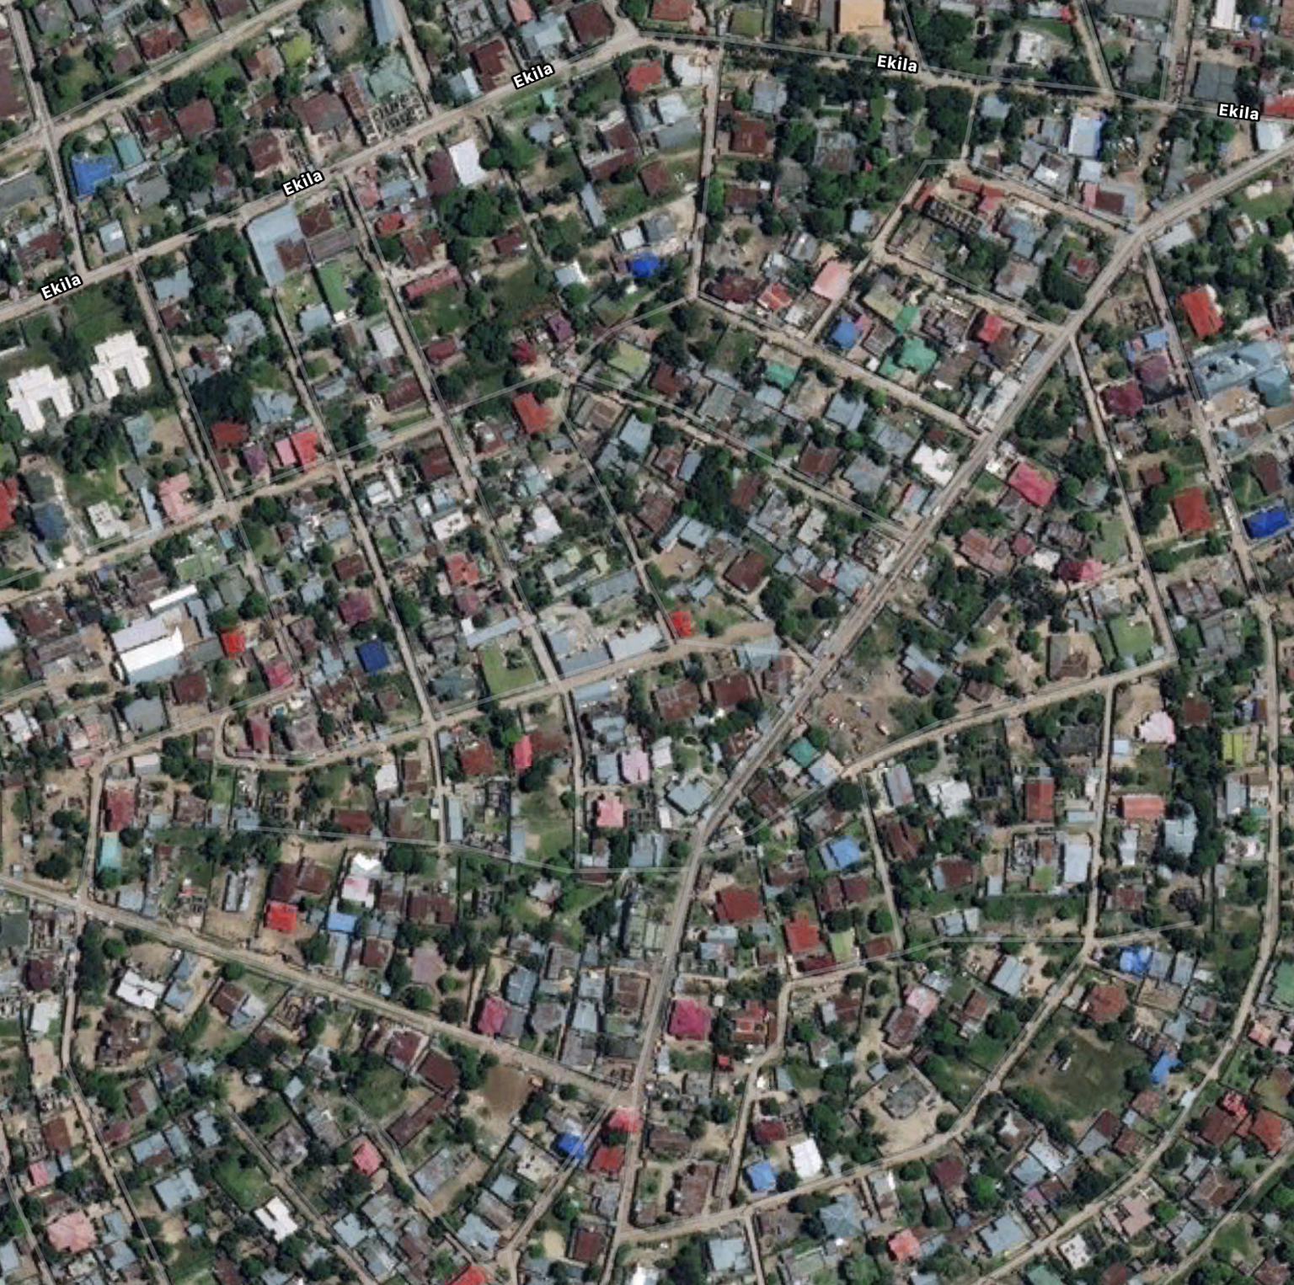
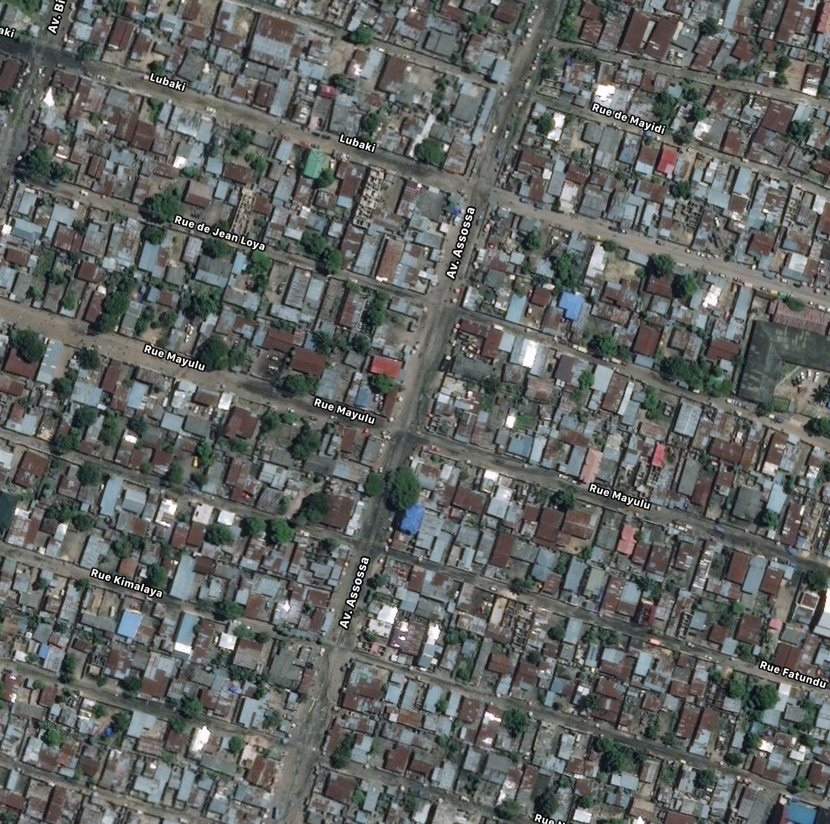
Survey 2 – quadrat characterisation
population density, wealth and accessibility

Slide 14
Survey 3 - consumer survey
December 2017 and June 2018
Timed street-intercept approach
Two assistants, one day, one quadrat
605 interviews in Brazzaville
556 interviews in Kinshasa
Total sample – 1382 (inc. PNR)
Socio-demographic
Behavioural
Psychographic

Slide 15
Survey 4 – restaurant survey
September – October 2018
All restaurants in 50% of quadrats revisited (n=388)
Observation + interviews
86 interviews in Brazzaville
131 interviews in Kinshasa
Restaurants in quadrat #35

Slide 16
Survey 5 – market survey
September – October 2018
All markets revisited (n=56)
Observation
Presence/absence of bushmeat

Slide 17
The context: most important proteins
Pointe Noire | Kinshasa | Brazzaville
1. Fish | 1. Fish | 1. Fish
2. Eggs | 2. Beans | 2. Poultry
3. Poultry | 3. Eggs | 3. Eggs
4. Beans | 4. Poultry | 4. Beans
Bushmeat is not important for food security in the cities studied

Slide 18
‘Occasional’ proteins
Pointe Noire | Kinshasa | Brazzaville
1. Beef | 1. Beef | 1. Bushmeat 63%
2. Pork | 2. Goat | 2. Beef
3. Bushmeat 35% | 3. Bushmeat 41% | 3. Pork
 | 4. Pork
Respondents ate these proteins at least once per quarter
350,000 people | 5,330,000 people | 1,260,000 people

Slide 19
Restaurants selling bushmeat
Restaurant type | Everyday | Weekly | Monthly | Infrequent | Never | Total | %
International | 0 | 1 | 1 | 0 | 3 | 5 | 40%
Formal | 2 | 10 | 2 | 0 | 14 | 28 | 50%
Informal | 4 | 35 | 11 | 10 | 105 | 165 | 36%
76 out of 198 restaurants (38%) overtly sold bushmeat
41% in Brazzaville and 37% in Kinshasa

Slide 20
Formative research – bushmeat consumers
Characterisation of frequent bushmeat consumers
Motives for and against consuming bushmeat
Situational and social context of bushmeat consumption
Species preferences

Slide 21
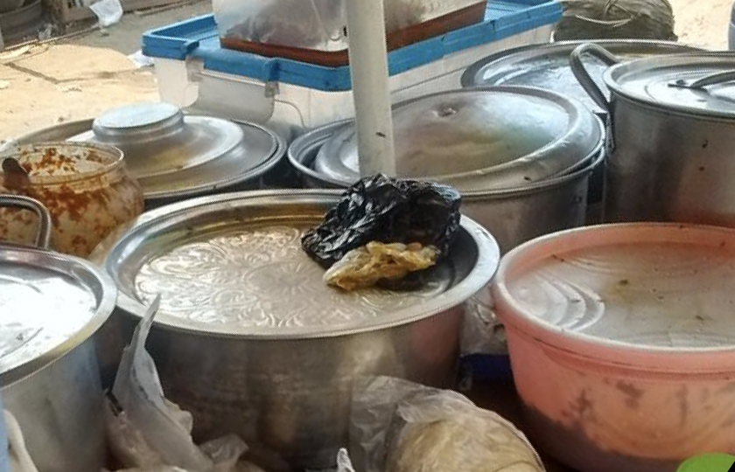
Formative research – bushmeat suppliers
Characterisation of restaurants overtly selling bushmeat
Location and clustering of bushmeat-selling restaurants and markets
Motives for and against trading and selling bushmeat

Slide 22
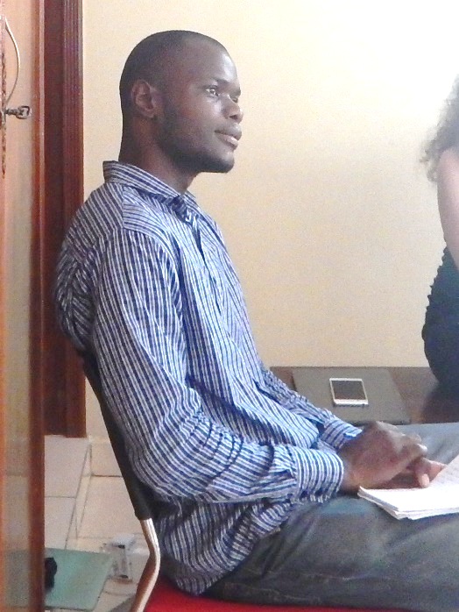
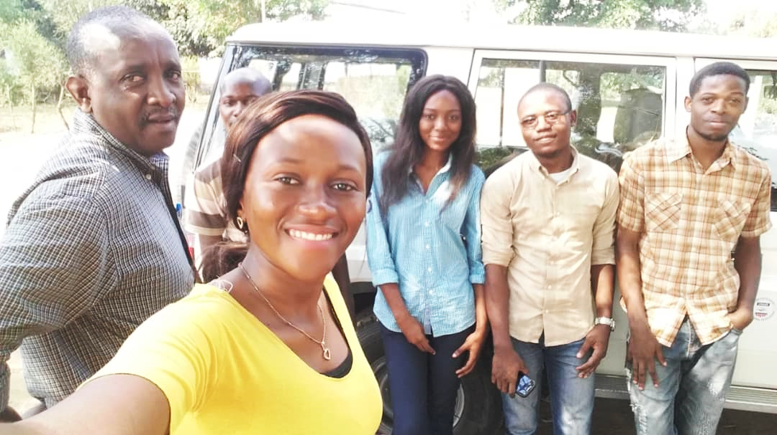
WCS Urban Bushmeat Project team

